Slide 1

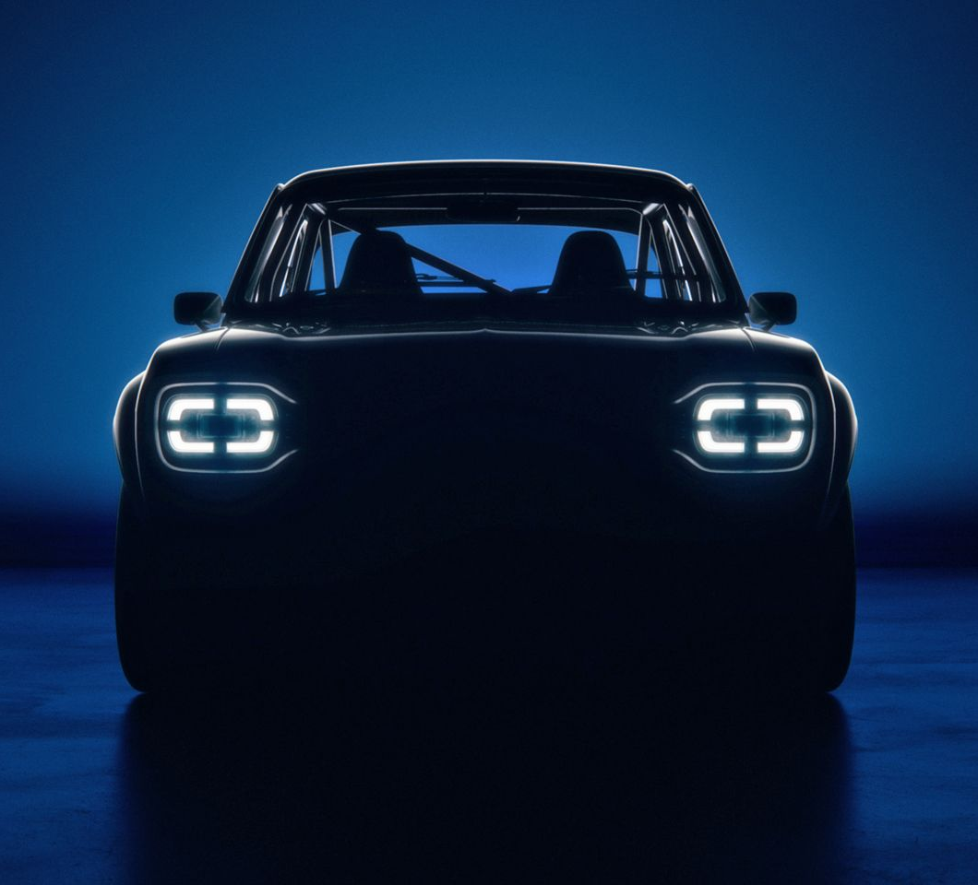

CARMAgeDDoN
Computer Vision and Machine Learning project
Notes:
Car
Analysis and
Recognition via
Machine-learning for
Automotive
Disambiguation with
Deep Learning
Networks

Slide 2

Project goals
Brand identification of car
Non-cleaned, high variability datasets (<-> Stanford Cars; VMMRdb; …)
Support goals:
Usability of image (scoring)
Angle of image (scoring)
Effect of cropping

Slide 3
PERSONAL goals
End-to-end project
Deep Learning

Slide 4
Impact
License plate fraud
App (ObsIdentify for cars)
Upload validation
…
End-to-end methodology

Slide 5
DATA (sourcing)
Autoscout
Listings:
Images
Brand
Model / model ID
Support features
Autodoc
Chassis codes
There be dragons:
Data linking

Slide 6
Data description & EDA

Slide 7


15,6 million images (839GB)
829 thousand listings
Table | Records
angletag_predicts | 15.647.260
angletags | 20.000
bintag_predicts | 15.647.260
images | 15.647.260
listings | 829.374

Slide 8
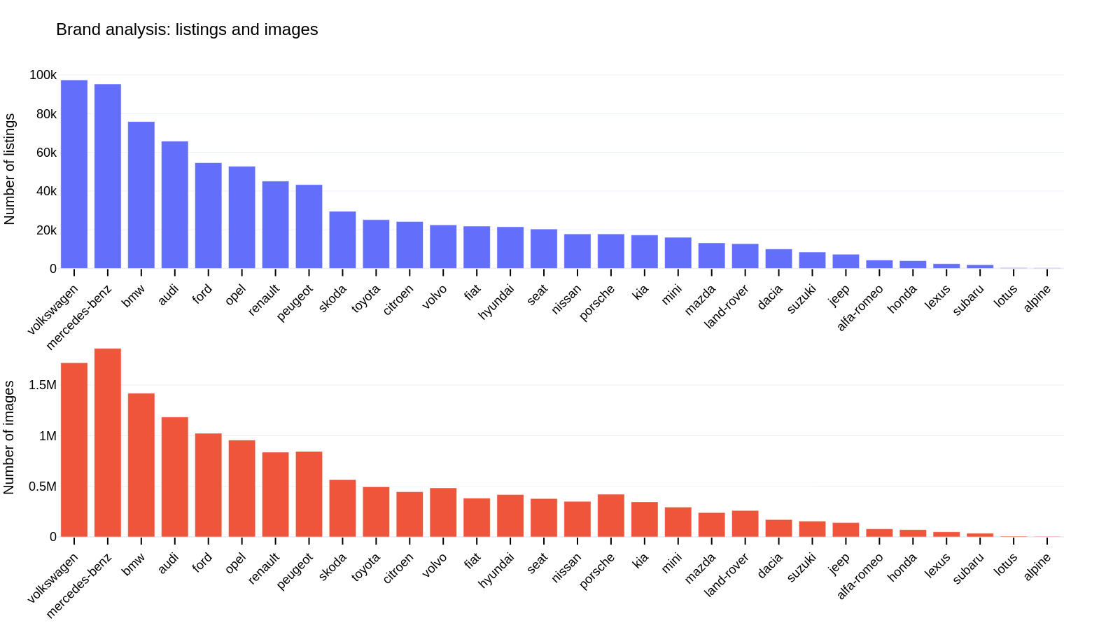

Slide 9
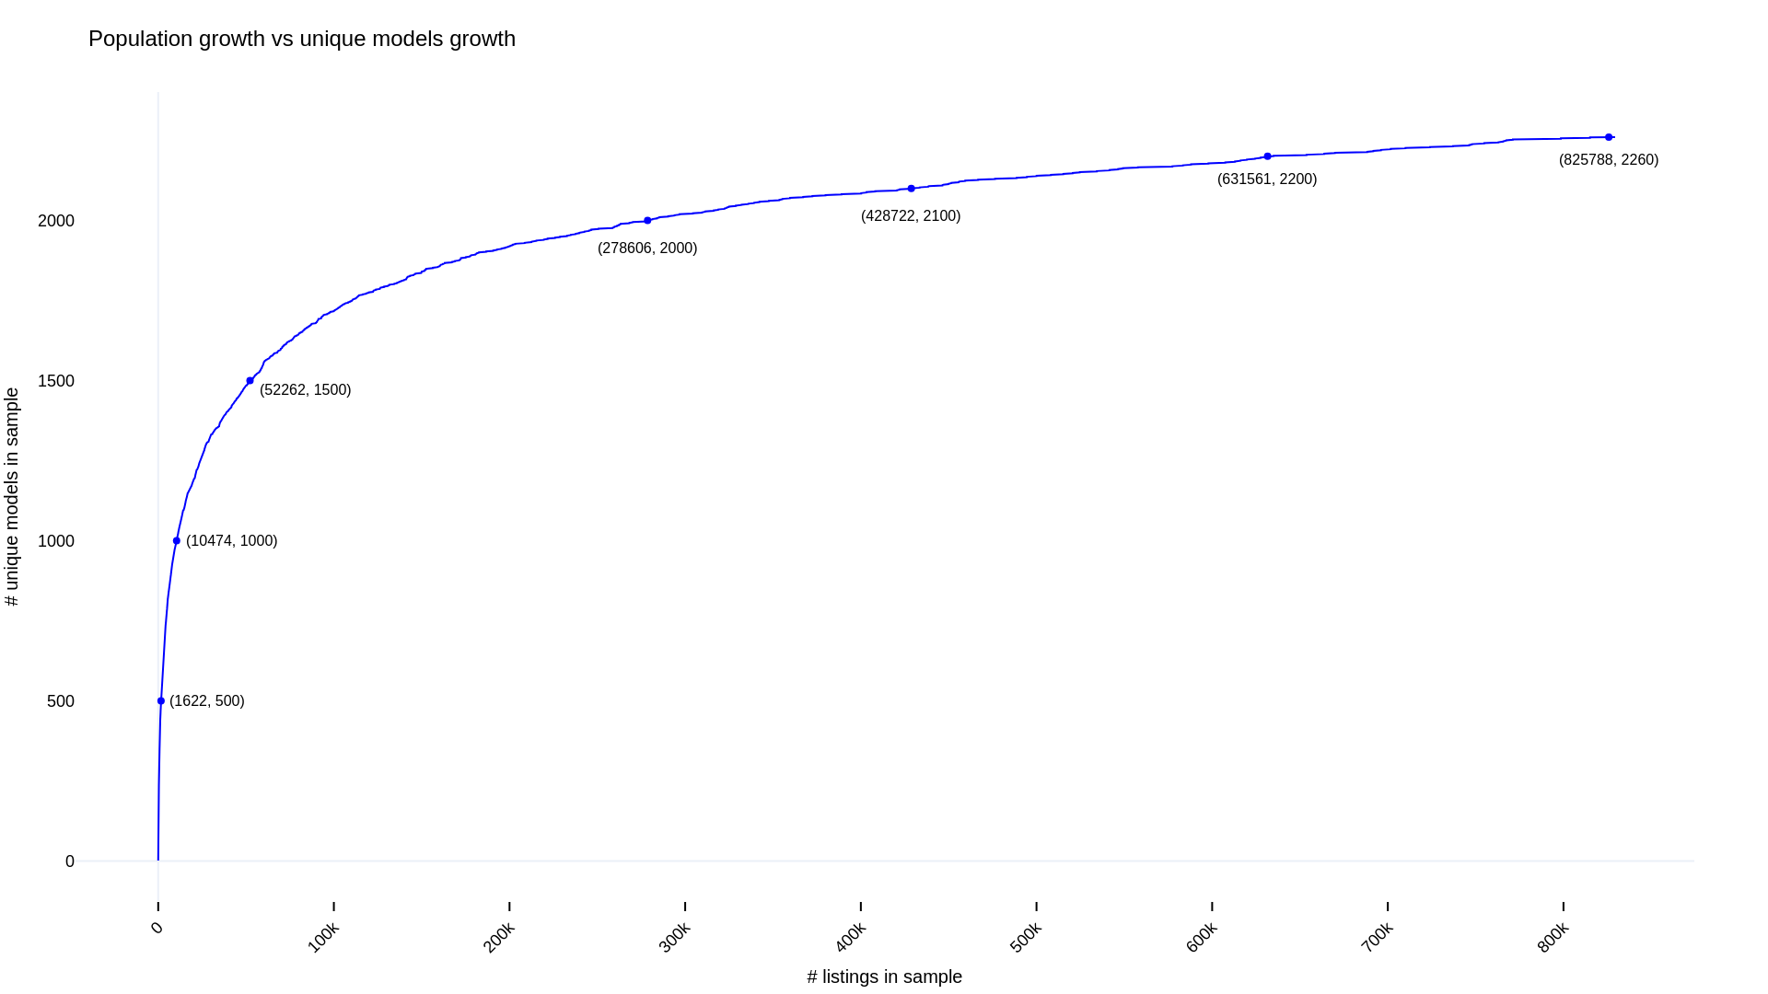
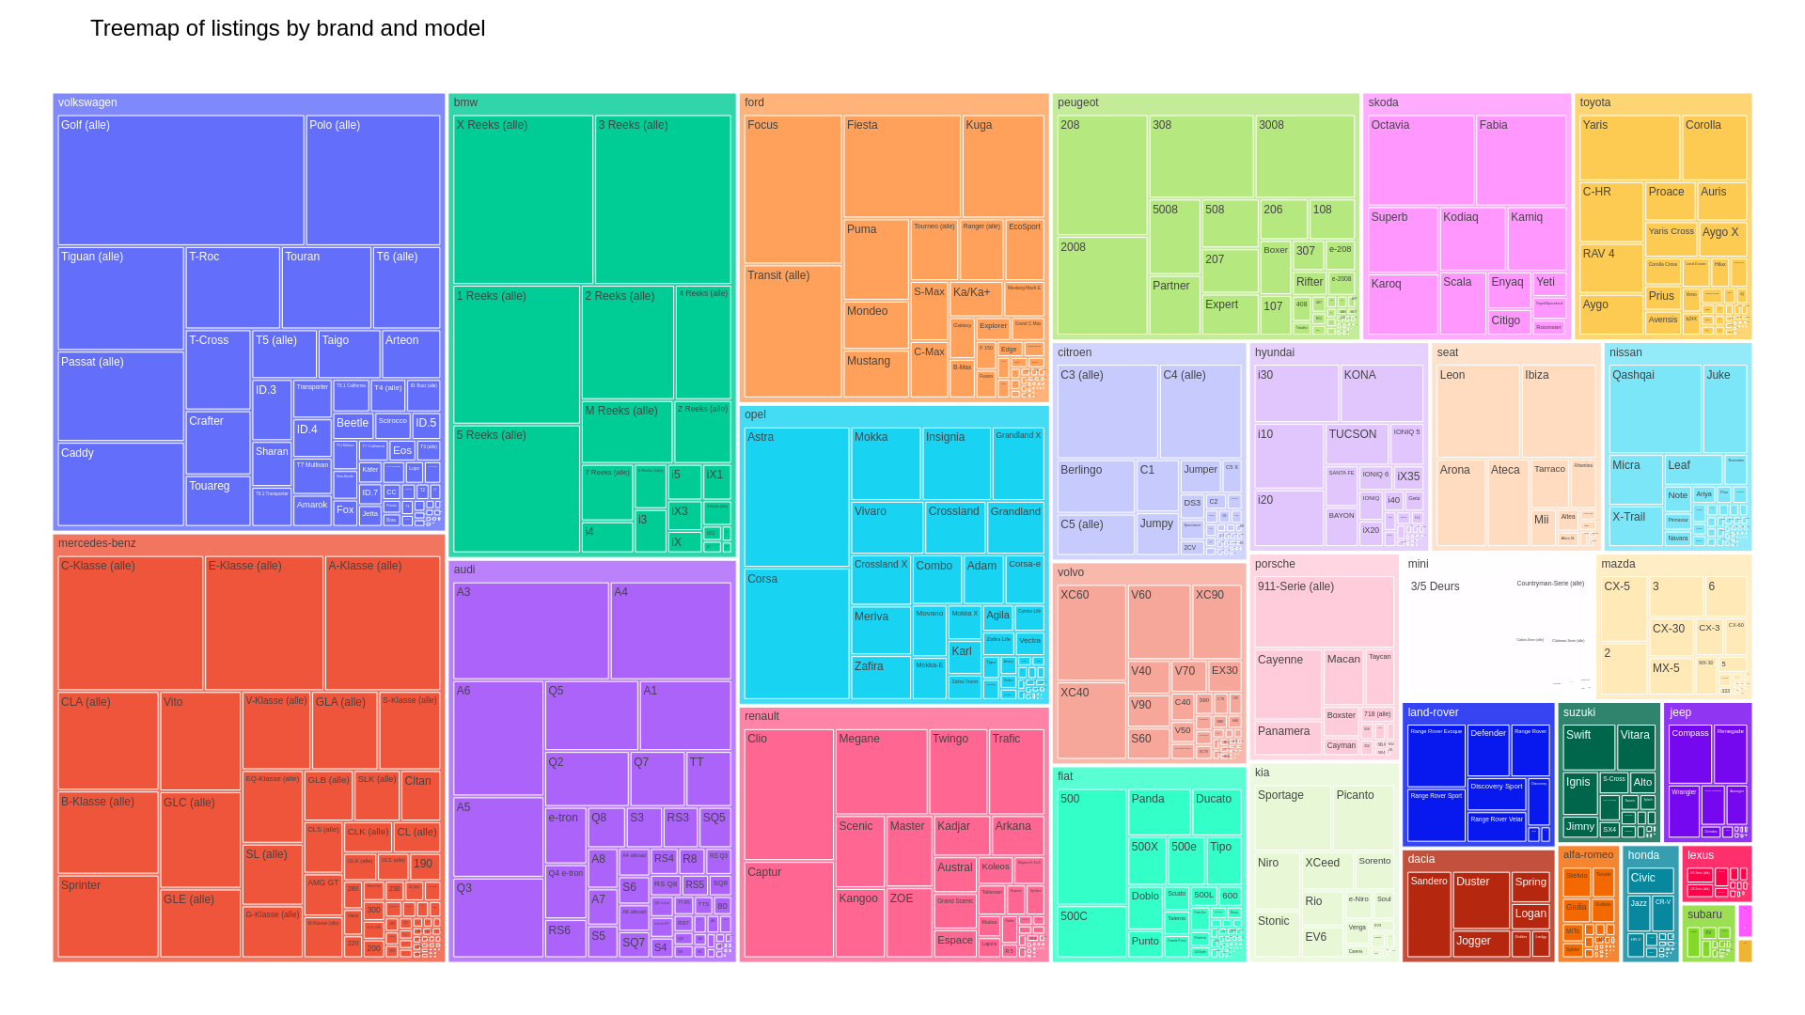

Slide 11
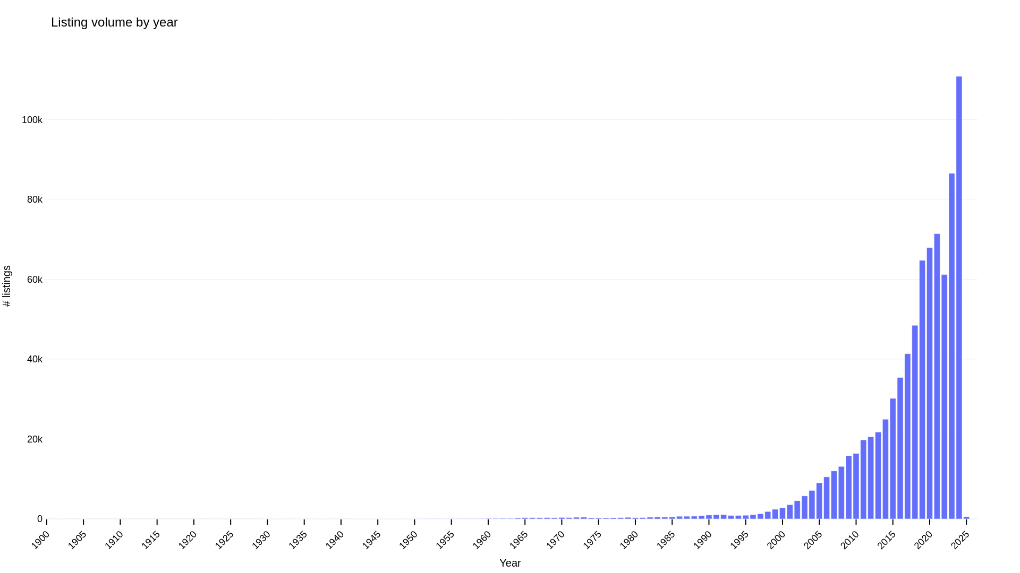

Slide 12
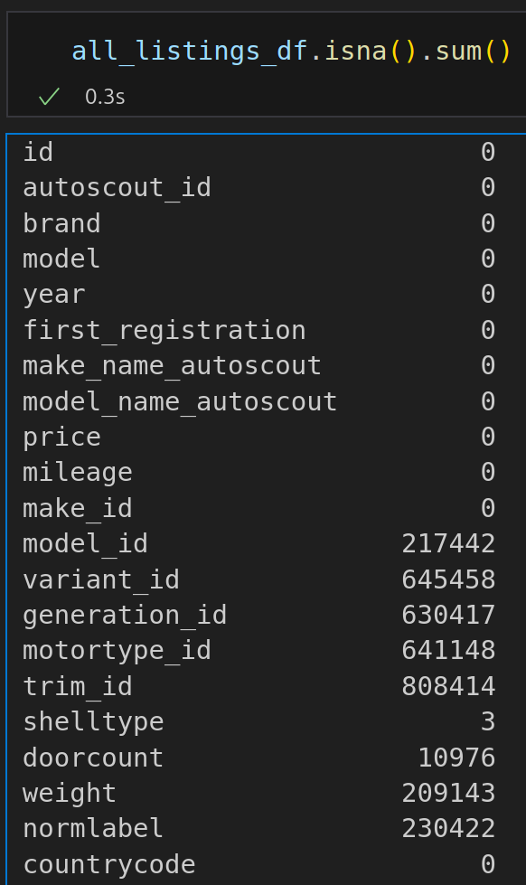
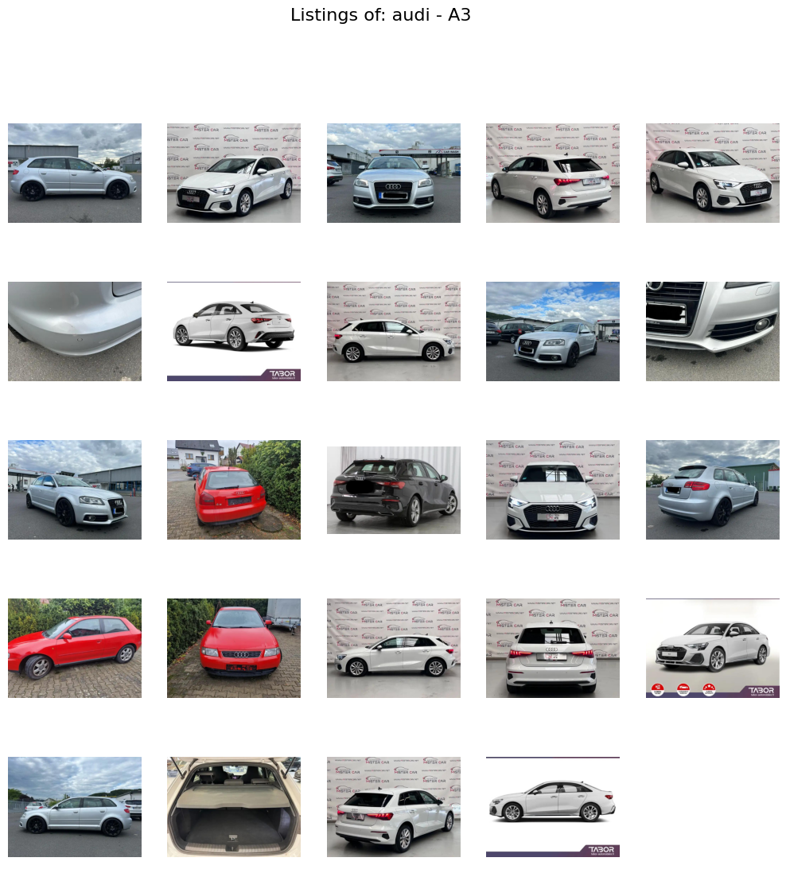

Slide 13
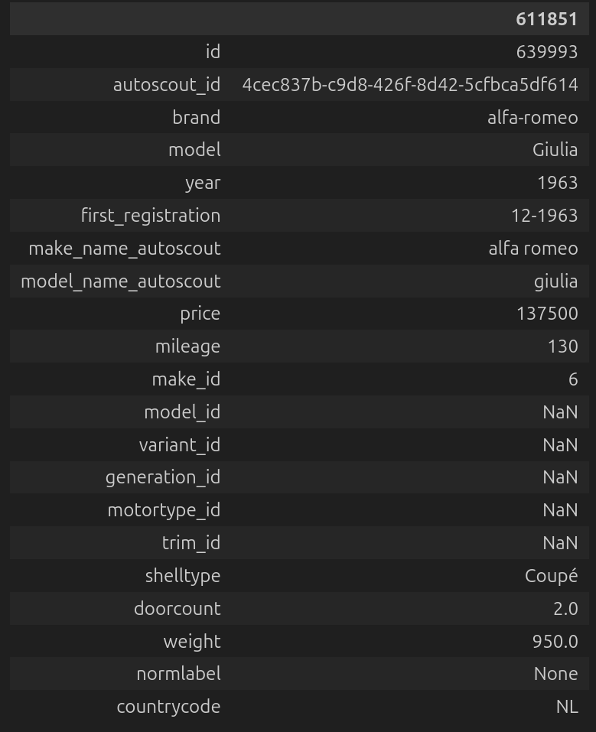
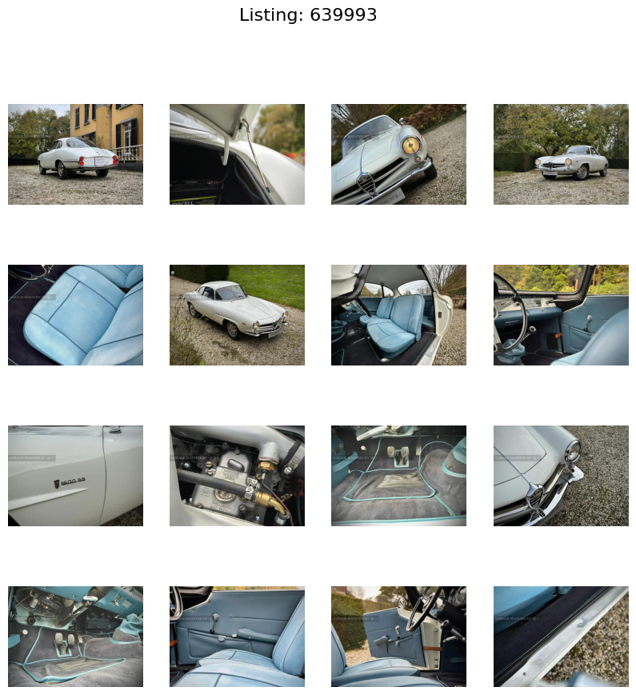



Slide 14
CAVEAT

Slide 15
Messy data

Slide 16
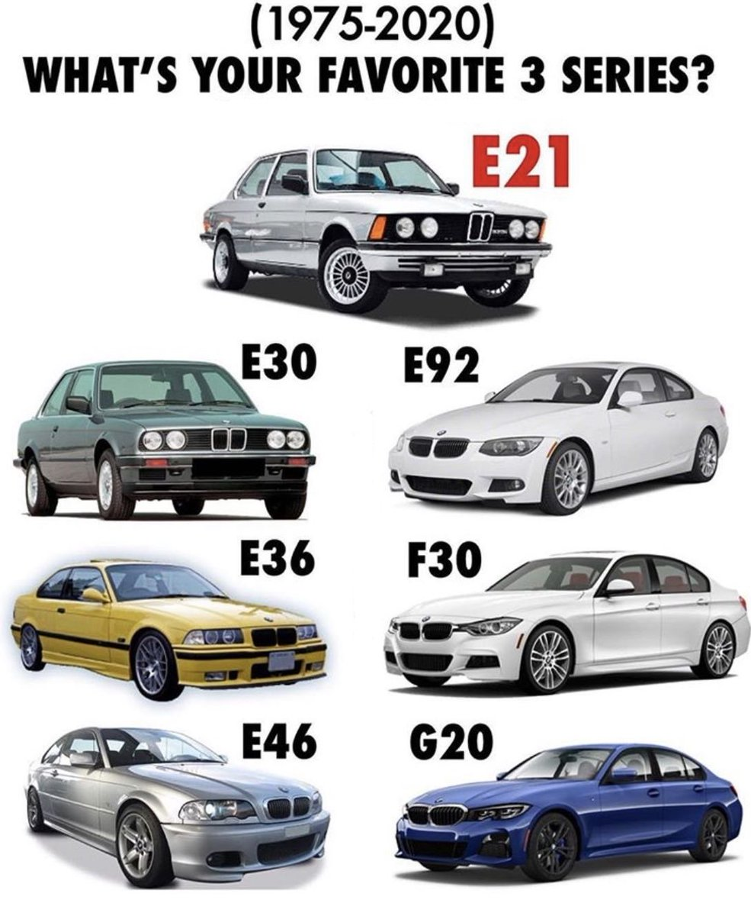
Incomplete data

Slide 17


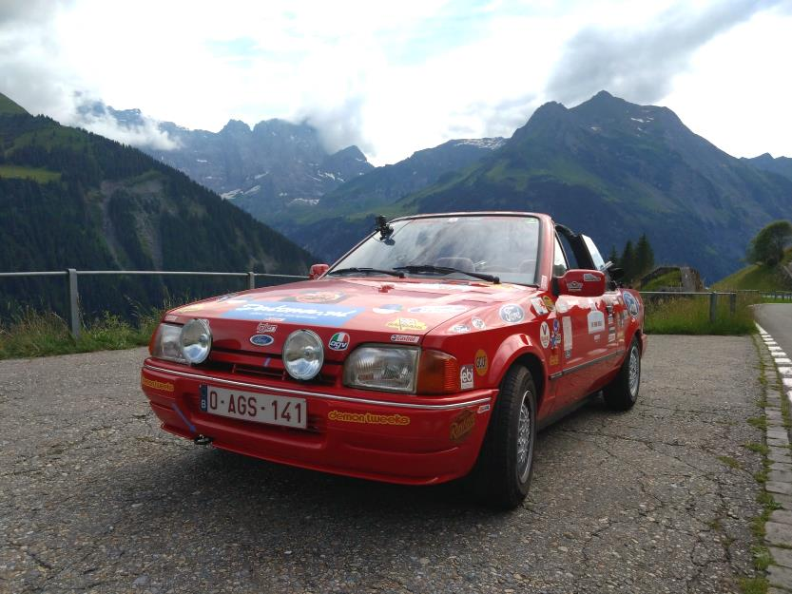
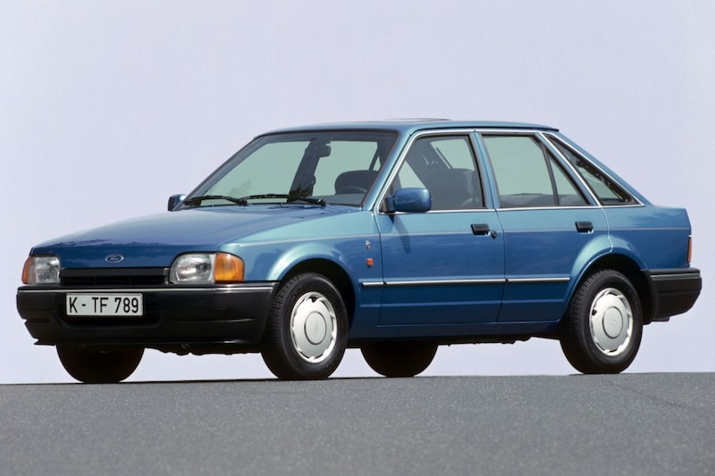
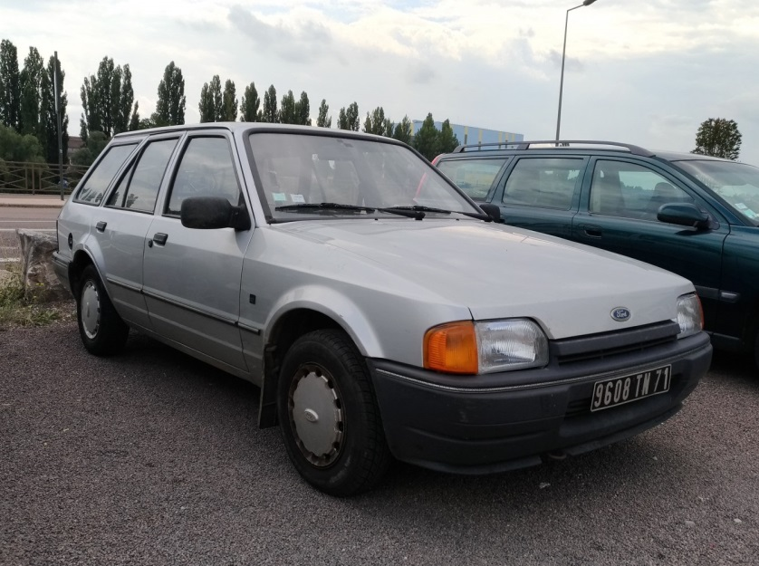
MK IV
Incomplete data
Cabriolet:
Escort MK IV (ALF)
Turnier (station wagon):
Escort MK IV (AVF)
5door hatch:
Escort MK IV (AWF)
3door hatch:
Escort MK IV (GAF)

Slide 18
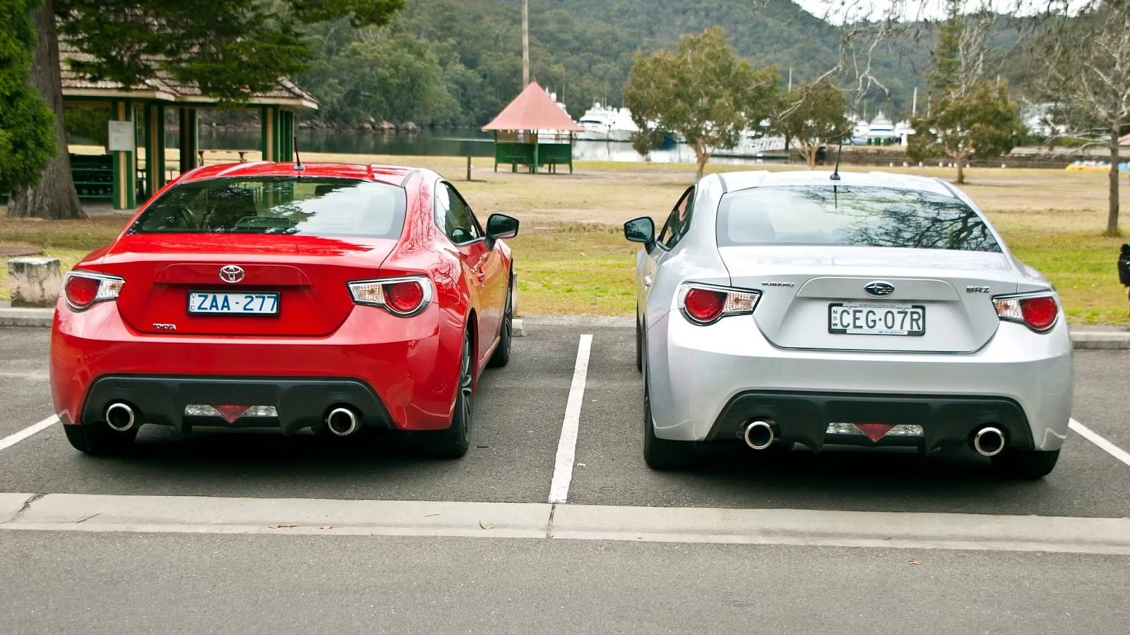
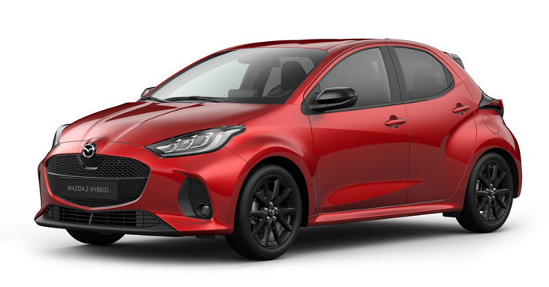
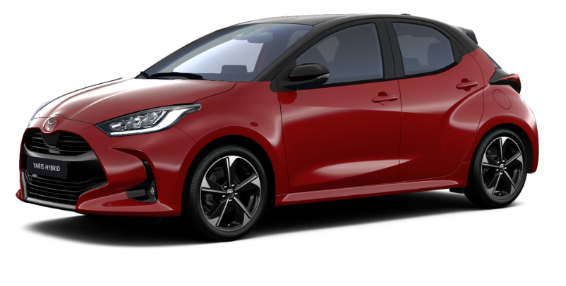
Toyota GT-86
Subaru BRZ
Rebadging: inter-brand confusion!
Mazda 2 (XP210)
Toyota Yaris (XP210)

Slide 19
Project intended implementation

Slide 20
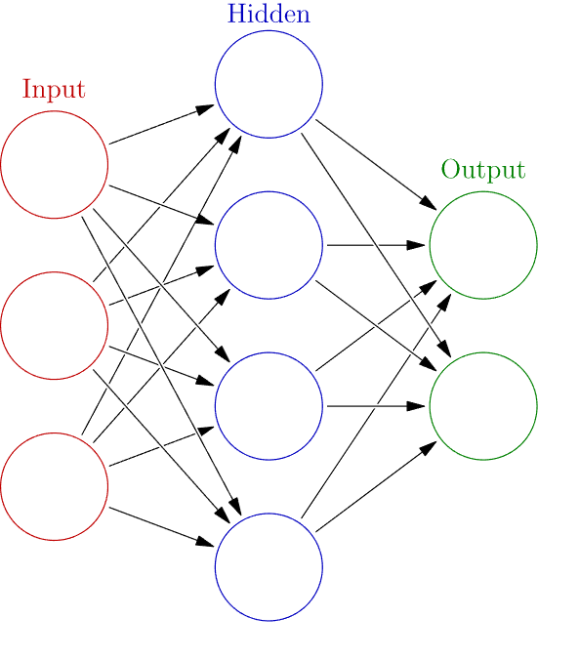


Deliverable pipeline
CNN1:
Bin tag
angle tag
CNN2:
brand classification
Bounding box:
x1,y1
x2,y2
CNN3a:
Model classification (audi)
CNN3b:
Model classification (fiat)

Slide 21
CNN1:
Bin tag
angle tag
CNN2:
brand classification
Bounding box:
x1,y1
x2,y2
CNN3a:
Model classification (audi)
CNN3b:
Model classification (fiat)

Slide 22
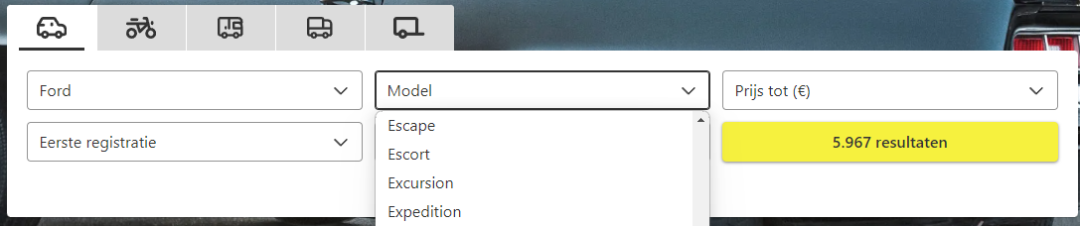
Data harvesting
Data Sources:
Autoscout (Listings)
Autodoc (chassis codes)
Merging data:
Pending task (based on support features)
Doorcount
Registration year
Shell type

Slide 23
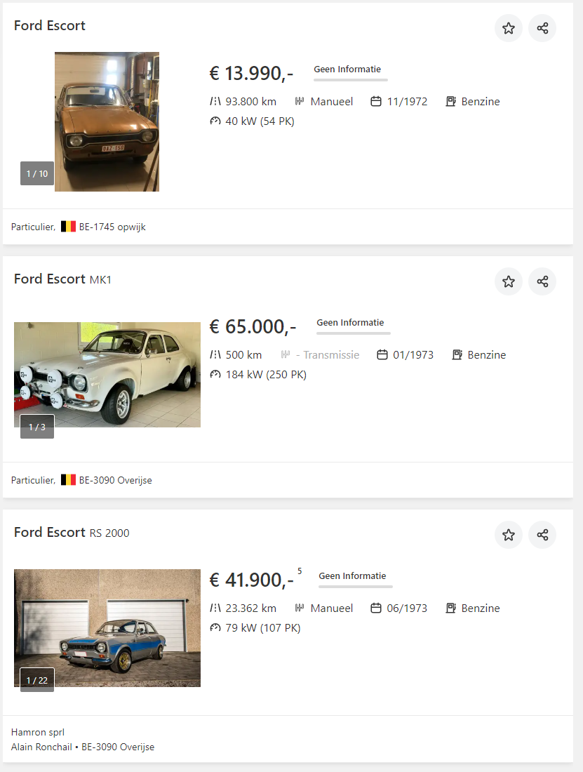
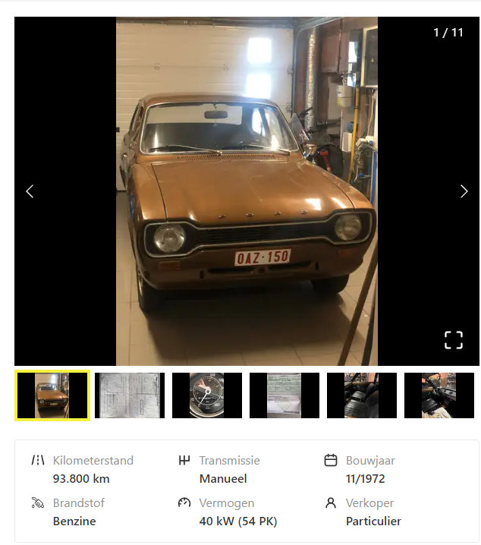
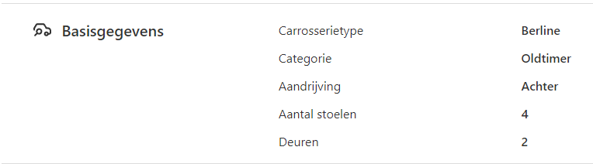
Data harvesting

Slide 24
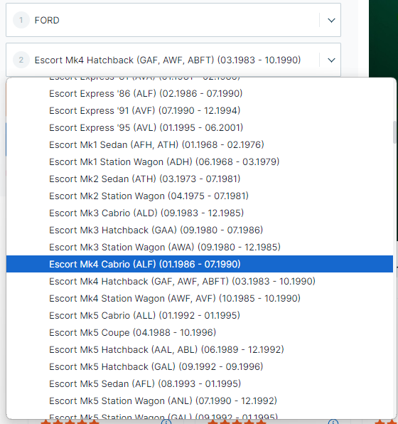
Data harvesting

Slide 25
CNN1:
Bin tag
angle tag
CNN2:
brand classification
Bounding box:
x1,y1
x2,y2
CNN3a:
Model classification (audi)
CNN3b:
Model classification (fiat)

Slide 26
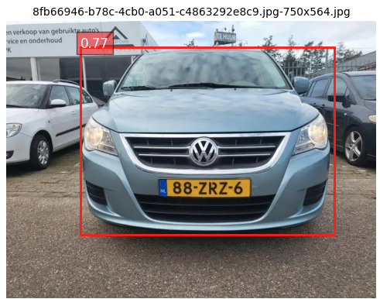
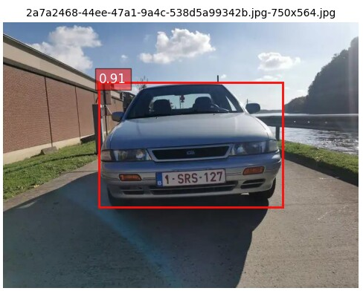
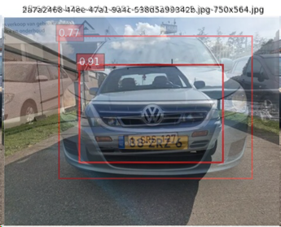
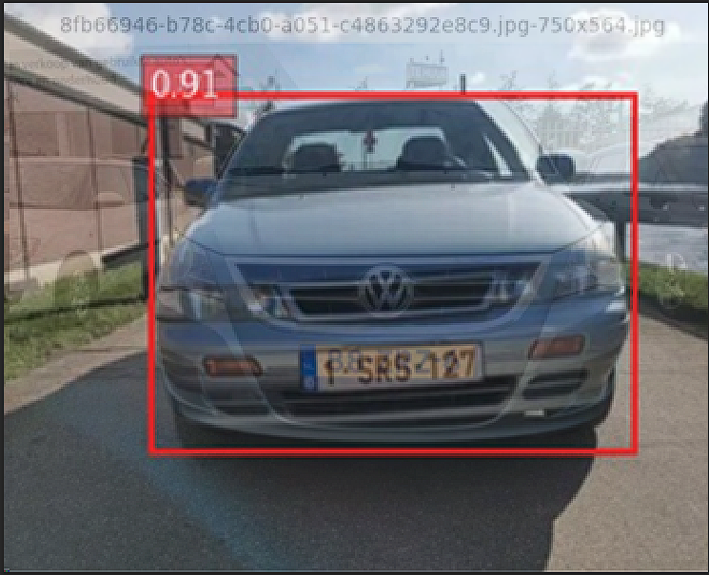
Bounding boxes
Real time object detection:
- https://www.datacamp.com/blog/yolo-object-detection-explained
- Speed (16million images) ➔ ca. 250h
- Custom rules (maxarea, minarea, mincertainty, biggest area…)
- GOAL:
- Crop the image to the relevant bit (the car)
- Why?: Neural networks require a square grid.

Slide 27
CNN1:
Bin tag
angle tag
CNN2:
brand classification
Bounding box:
x1,y1
x2,y2
CNN3a:
Model classification (audi)
CNN3b:
Model classification (fiat)

Slide 28

Bin + angle tag
No training data available:
Is an image useful?
What angle is the image taken at?
Solution: make your own training data
FLASK based tagger
Then Modelling:
2*2models:

Slide 29
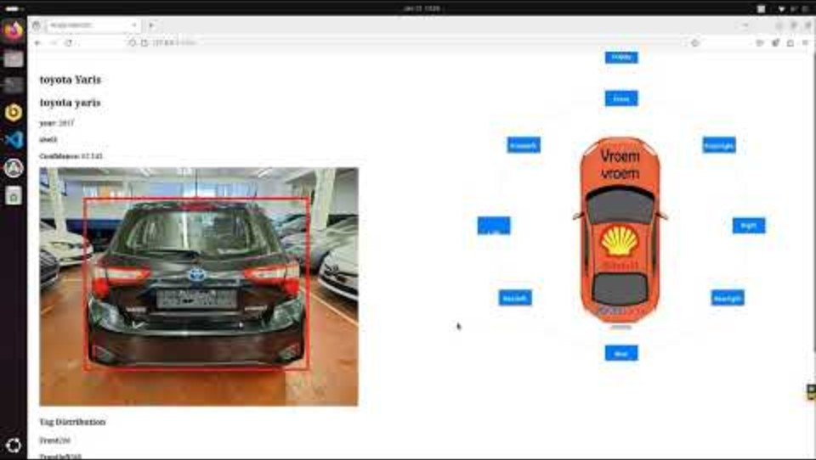



Bin + angle tag

Slide 30
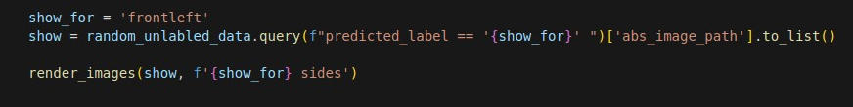
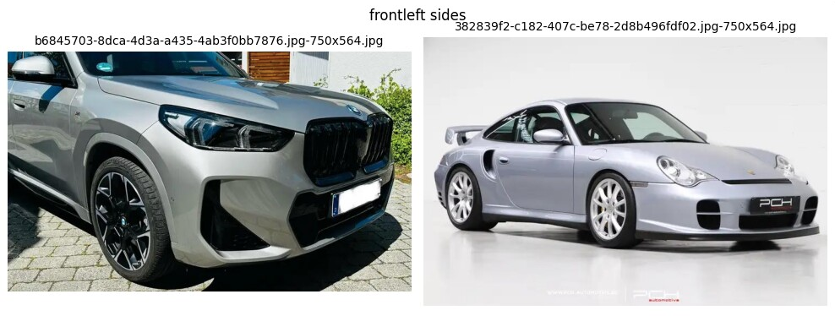
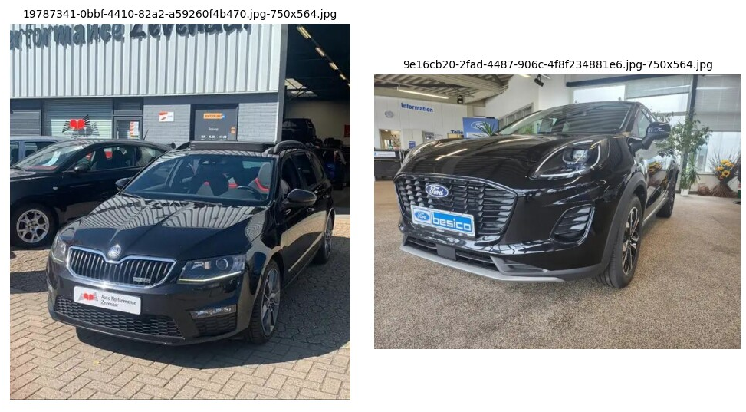
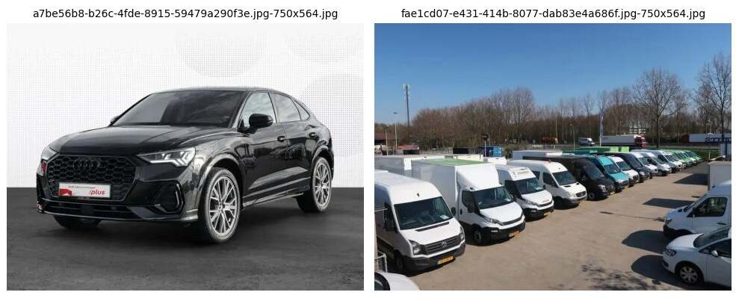
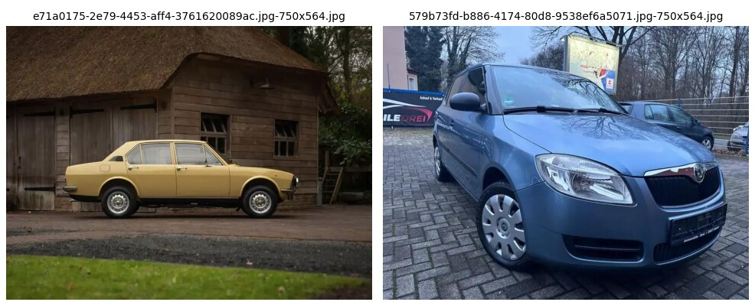
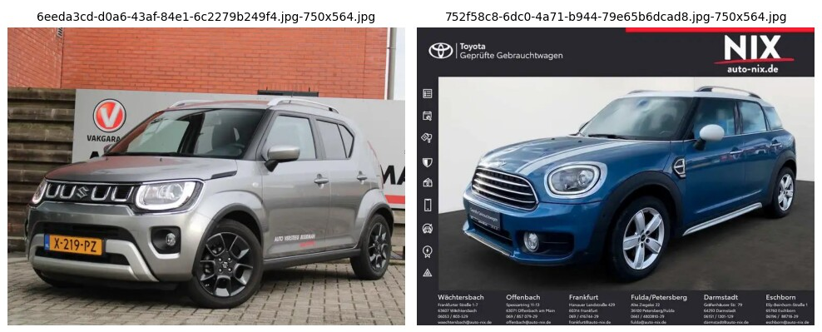
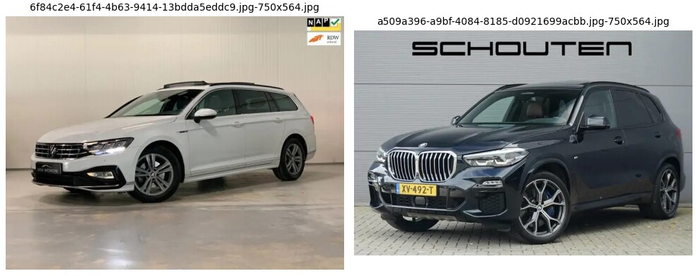
Bin + angle tag
Approach A
CNN | Resnet (feature extraction)
Binary tagger | RandomForest
Bin F1(False) | 94%
Bin F1 (True) | 96%
Angle tagger | KNN(5)

Slide 31
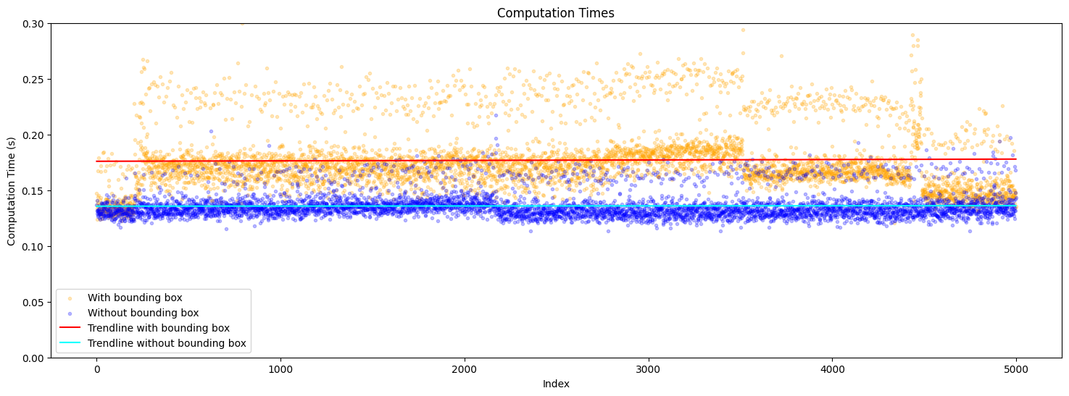
Bin + angle tag

Slide 32
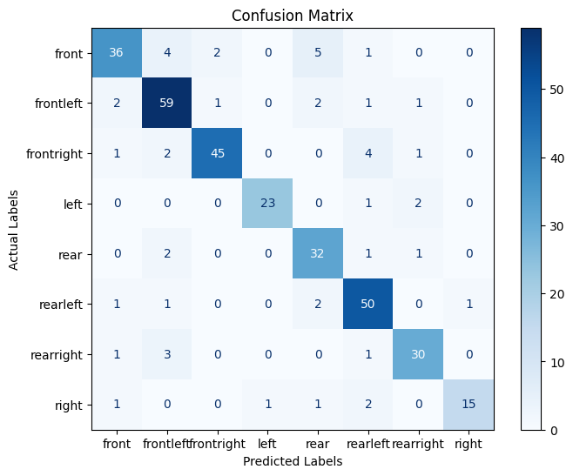
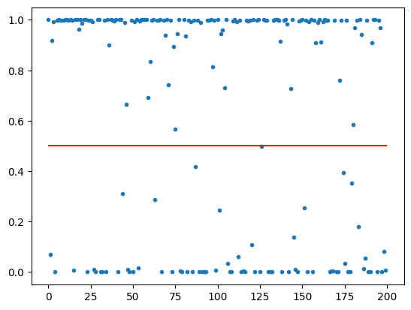
Bin + angle tag
Approach B
CNN | Keras Sequential
Binary tagger | Sequential
Angle tagger | Sequential
Angle tagger: CM
Is_crappy (binary tagger)

Slide 33
CNN1:
Bin tag
angle tag
CNN2:
brand classification
Bounding box:
x1,y1
x2,y2
CNN3a:
Model classification (audi)
CNN3b:
Model classification (fiat)

Slide 34

Brand classification
835GB: So out-of-core learning
Resnet18 (pretrained model)
CPU learning: 10h for 67.740 images
CPU predicting: 5h for 500.000 images

Slide 35
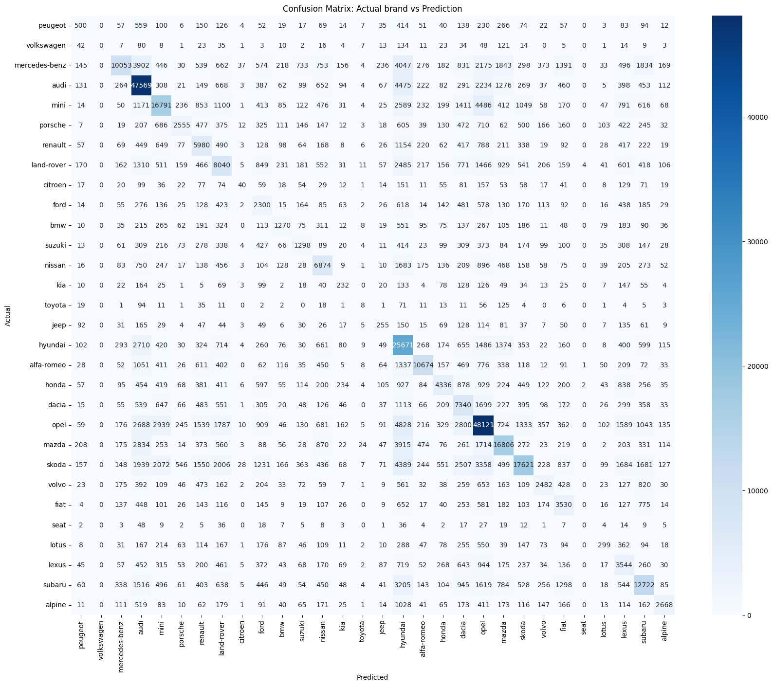
Not great BUT remember:
Preprocessing not fully implemented:
- Binary tagger
- Angle tagger
2) Very small fraction used in training:
- 0,433%

Slide 36
Q&A

